Slide 1
Reading Other People’s Code
A Workshop To Improve Code-reading Skills
The Seven Stages of Reading Someone Else’s Code
😀😳😬🤬🥺😫😭
Hosted by Selene Schmittling
Through
The Peer Scholars Program
Notes:
This workshop is designed to provide some high-level tools to make reading other people’s code easier. Note that it will never be easy, seasoned programmers loathe this part of their job. However, the topics in this session should reduce frustration and make the task less frustrating.
We'll have some interactive portions where I will pose questions and give you time to answer. It isn’t important that you get the answers correct. Just that you try to answer them and, more importantly, understand the answers.

Slide 2

Welcome!
Who Am I?
PhD Student in ECE
A student consultant for DVS in the NCSU Libraries
Wife, Mother of a Human, Cats, Lizards, Cavies, Beetles
Eastern Hercules Beetle
(not Sonic)
Photo from: https://nature.mdc.mo.gov/discover-nature/field-guide/eastern-hercules-beetle
Notes:
My name is Selene Schmittling and I’m a PhD student in the Department of Electrical and Computer Engineering. I am a consultant for the Data Visualization Services Department in the NCSU Library system. I am also a wife and mother to multiple organisms: including an interesting and generally-lovable 19-year-old, and two cats. Previously, I have also nurtured a cavy, an anole and a Hercules Beetle named Sonic.

Slide 3
Workshop Objectives
By the end of this Workshop …
You will be able to recognize basic data types and operators and understand why you should be aware of them.
Have a high-level understanding of control structures
Know the basic parts of a function and understand where to look for information
Have a high-level understanding of object-oriented programming and how to identify object-oriented code from functions
Notes:
I designed this workshop because, increasingly, I find myself interacting with people from diverse professional backgrounds who have to use and modify computer code without any requisite background. Frequently, they are using code that was generated by people who also didn’t have solid programming experience!
While resources abound to learn programming, it can still be frustrating without a high level understanding of core principals of understanding code and how computers interact with code in general. This workshop is designed to provide some of that.
By the end of the Workshop…
This Workshop is not language specific, but we’ll look at examples in MATLAB, Python and R. The main take away should be: if I need to work in < fill in the name of a programming language> these are the things I should work to recognize and understand in this language to make my program work.

Slide 4
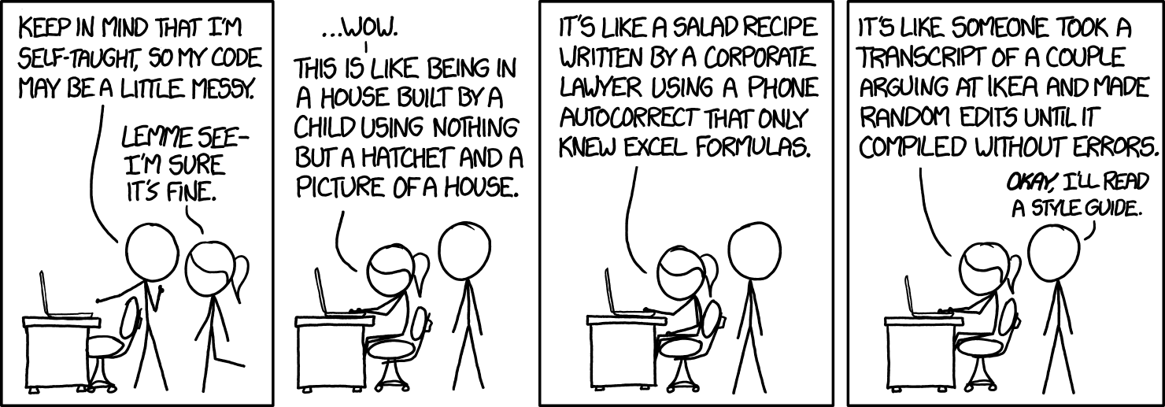
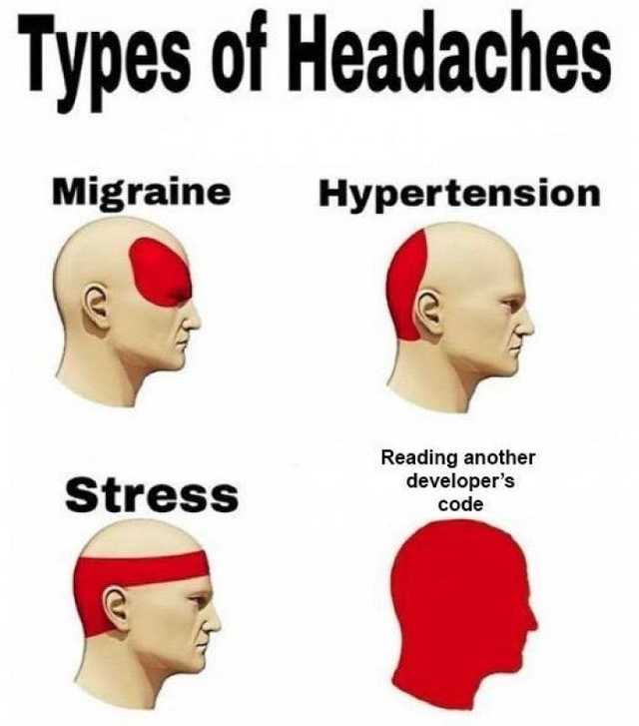
Reading Other’s Code
https://xkcd.com/1513/
https://xkcd.com/1833/
u/bahocit in r/ProgrammerHumor
On Reddit
Notes:
It’s not just you.
As these cartoons suggest, reading other people’s code is dreaded by people who do this for a living.
It used to be “computational literacy” meant being familiar with software associated with a given field. These days people from diverse backgrounds are finding that “computer literacy” now includes being able to understand and implement code in a variety of languages.
In biological fields, sociology and psychology, data analysis is increasingly being done in open-source environments, like R or Python, that require some coding experience. Alternatively, you might encounter equipment that runs through the use of coded scripts. My husband’s company was recently given some equipment to try that was run using python scripts. While a graphical user-interface provided functionality, to use the instrument for unique experiments, python scripts had to be written.

Slide 5

If someone hands you code…
Questions to Ask:
What is the overall goal of this code?
What kinds of inputs does it expect?
What is the format of imported data?
What types of outputs will it provide?
How will I know it worked? Or didn’t?
Notes:
So, where do you start? First, if someone hands you code, ask these questions.
If you get code from the web or a book, then read any descriptions available (references, readme files, etc.) and try to answer these same questions.
You attack reading code in a similar fashion to reading scientific papers. High-level first then in detail. This means don’t try to understand what the code is doing initially, just familiarize yourself with the terrain. Look at what libraries are required, if any; comments and variable names (do they provide you with information?). Note if the code broken up in a particular way or if code is repeated.

Slide 6
Data Types
Data type | Example
Integer | 5; 10; 250; 4,354,765,122
Double or Floating Point | 4.5, 0.00000947, 256.8734
Boolean | True/False or 1/0
Character | ”a”, “*”, “”””
String | “More than one char.”
Date/Time | 3/18/2021; 03:44:06
What do you need to know?
What kind are supported?
What sizes supported?
How are chars & strings handled?
Notes:
Data type refers to the form of variables available in your language. It is related to how the value is stored in the computer. Being familiar with datatypes is important, particularly when you are importing data or performing operations on data.
Most people understand the different datatypes. The important thing is to be aware of what types your language allows. Being aware of datatype is also important when we talk about functions later in the presentation. Functions may have values, called parameters, that get passed into them (input) and return values (output). It is important that you are aware of the datatypes that the function expects. You may pass variables, which are one or more values; or an object. We will talk more about objects later.
If you encounter a datatype that you aren’t familiar with or if you aren’t familiar with them in general: I encourage you to read up on them in the language’s documentation.

Slide 7
Data Storage Types
Data Storage Types
Matrix, vector, tensor
Cell (MATLAB)
Table / Data frame
List
Tuple
factor
Dictionary (python)
What do you need to know?
What storage types available?
What data types do they store?
Syntax for storing/accessing?
Notes:
Each program has different ways to store data. You store values, data and objects in variables. Variables can be scalar (one quantity) or multi-dimensional (e.g., vectors, matrices, tables). Some store only one data type at a time, while others store multiple data types at a time. Each language will have its own constructs. Familiarize yourself with how to recognize the different ones and what types of data they store.

Slide 8
Variables, Data Types and Data Storage
Related Concepts
Variables store values and objects.
Variables can represent
single value/datatype
Data storage which may hold multiple data types
Variables are just a way to store information for
retrieval
manipulation

Slide 9
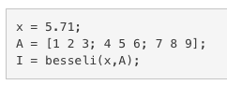
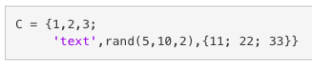
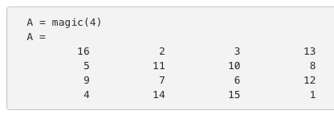
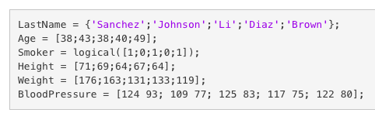
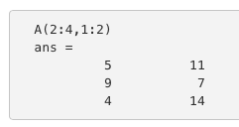
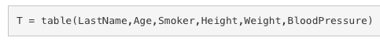
Code Break: Variables
①
②
③
⑤
④
⑥
Are these variables 1D or multi-D? Integer? Float? One datatype or multiple?
Notes:
1-D. Single datatype. Double or float
Multi-D. Single datatype. Integer.
Can’t tell from this example. I is the output of a function whose input is x and A. Any ideas how you could figure out what type of variable I might be?
A is multi-D. It’s a matrix and a single datatype.
multi-D, multiple data types: integer, text. This construct is called a cell which is unique to MATLAB. Cells allow different types of data to be stored, more importantly the length of the data in each cell can be different. This sets it apart from a table. Interestingly, one element is the output of a function [rand(5,10,2)] and one is itself a cell!!!
This is multi-D, multi-data type

Slide 10
Operators
Type
Assignment
Arithmetic
Relational
Logical
Set/Membership
Identity (Python)
Bit-wise
What do you need to know?
unary? binary?
Which available?
Syntax for storing/accessing?
Notes:
If you have variables, you need operators! Operators let you set, compare, and manipulate variables. You want to know …
The first four types are most commonly used.
Assignment: usually “=“.
Arithmetic: addition, subtraction, multiplication, division, modulo
Relational or Comparative: greater than, less than, equal to: “=“ is not the same as “==“
Logical: & (and), | (or), ~ ! or NOT, logical not
The last three may be present as operators OR functions. Set membership indicates things like union, intersection, etc. Python has special Identity operators that can be useful. If you have to compare items and/or work in Python, I’d look into these.
Bit-wise operators are operators designed to do operations on bits: single 0s or 1s. Bit-wise AND / OR operations work differently than other logical operators. Learn about them if you need to.

Slide 11
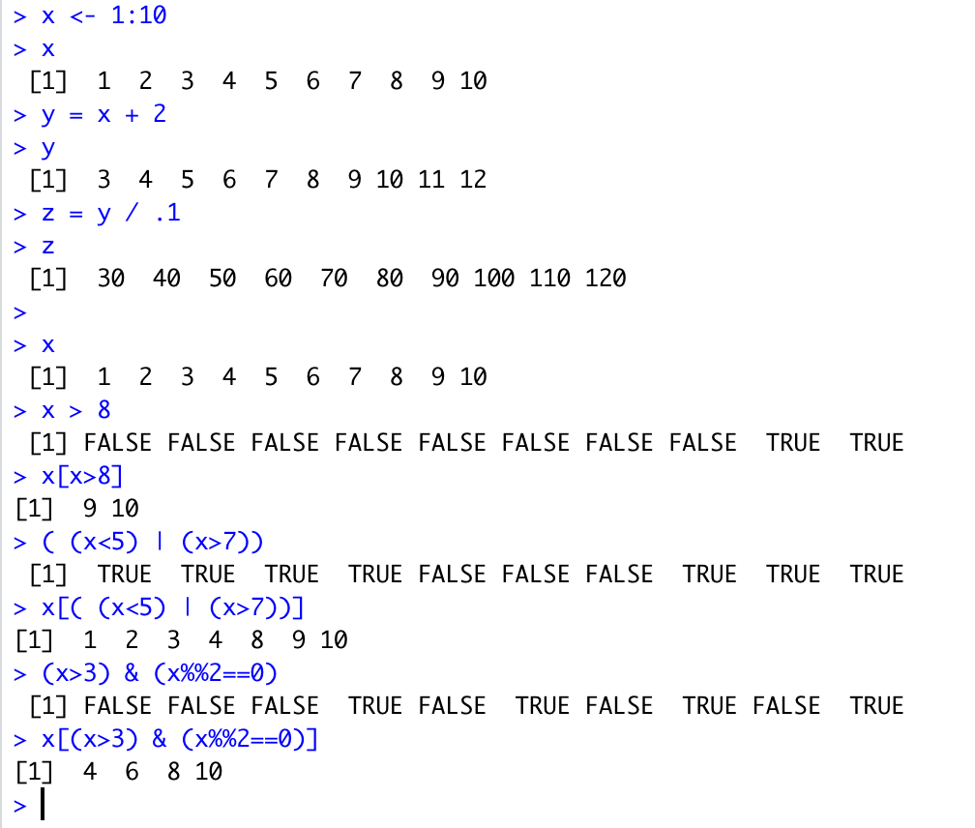
Code Break: Operators
①
②
What types of operators are represented here?
arithmetic?
assignment?
relational?
logical?
R Code
③
➎
④
➏
Notes:
This is assignment operator! This form is unique to R.
Also assignment and arithmetic, this is the more traditional form. You can use both in R.
Relational
Relational and logical
This looks gross…anyone want to take a guess what’s happening here? Basically, a relational operator is being used to identify elements of x that meet this criteria
You didn’t think it could get worse and then this…this is doing the same thing as (5) except it is using relational and logical operators to identify a criteria. Anyone want to Google ‘%%’ and R and tell me what that does?

Slide 12
Conditional Statements & Loops
What do you need to know?
For vs. while
If: Logical / Relational Operators
Switch
Statements
If
For
While
[List] Comprehensions
Switch
Notes:
Conditional statements let you execute code…well…conditionally. For most languages, the conditional statement is the IF statement. IF statements use variables as well as relational and/or logical operators. They evaluate to a Boolean value (true or false). If the statement evaluates to true, then the code following the if statement is executed, otherwise it isn’t. If statements can be nested and usually come with an “else” clause which allows you to do something different if the statement evaluates to “false”.
Loops allow you to perform repetitive tasks, or access elements in data structures (e.g., lists, vectors, matrices). They can be nested. For example, to access matrix elements (rows & columns) you would use one for loop nested in another (to access the row and column of an element). There are two dominant kinds of loops: For and While. The difference between the two is that in the case of “for” loops, we know how many times the loop will execute (for i = 1 to 100). While loops, on the other hand, run until some condition is met (i.e., while x < 10). Which you use just depends on what information you have.
The trick to understanding conditional structures is to try to understand 1) the value of the loop variable(s) before the loop starts, 2) how values are updated in the loop and 3) what value makes the loop stop. You want to get off the Ferris Wheel at some point!
Python introduces comprehensions which are loop-like structures that make traversing lists and dictionaries intuitive and easy. If you have to work with python code and don’t know about them, I suggest taking the time to learn.
You might see switch statements (not all languages have them). Switch statements let you execute code based on the value of a variable. They provide an easier-to-read alternative to nested IF statements.

Slide 13
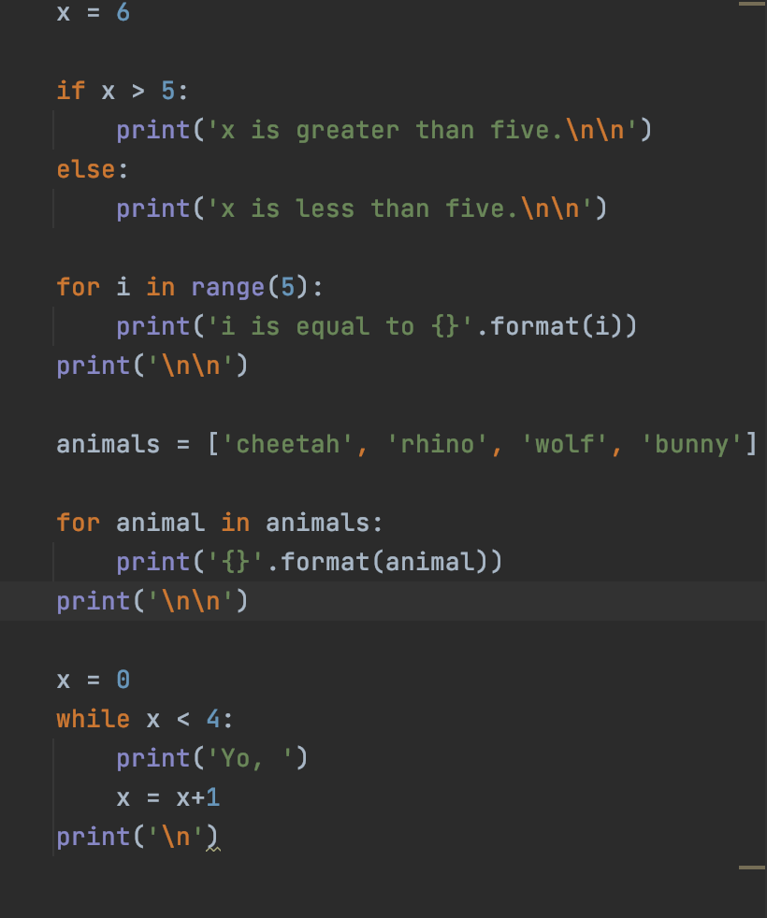
Code Break: Loops & Conditionals
What’s the Output of A?
1 or 2?
Code:
①
Ⓐ
②
What’s the Final Output of B?
“i is equal to ______” 4 or 5?
Python
Ⓑ
How many times will ‘Yo, ‘ be printed in C?
Ⓒ
Notes:
Here are some examples in Python. Don’t be afraid to use common sense here to take a stab at answering these questions.
For the if statement which sentence is going to print out?
The for loop will execute the print statement how many times.
This is an example of a list comprehension. Just note how intuitive the code is.
This is a while statement. How many times will it execute?
Can anyone tell me what is really important to include inside the while loop?
ANSWER: make sure you are changing the value of your looping variable. Also make sure that you will eventually meet the stopping criteria for the loop!
Would you want to define the variable you are checking inside the while loop?
ANSWER: Nopity, nope, nope, nope. If you do that, it is very likely you will never meet the condition you are checking. And while endless love is romantic, endless loops are not.

Slide 14
Functions: Types
Packages | User-Defined
Base (included) | In current file
Library (require libraries) | Called from current file
Packaged Functions
Base functions included
Library functions require library
Look at documentation!
User-defined Functions
Must be included in code
May require additional file
Notes:
Functions let you reduce repetitive code. Almost all basic tasks in programming are going to involve functions. One rule of thumb suggests that you should put code into a function if it is repeated more than two times.
There are two broad types of functions: pre-defined and user-defined. Pre-defined functions are either provided as part of the core language or available through a library that can be called. User-defined functions are just that, defined by a user.
Pre-defined functions should have documentation associated with them. This documentation should tell you the types of input the function expects, what it returns and generally what it does. Important to remember is that a function may be flexible and accept different types of input. This may have an impact on what the function returns or how it behaves.
User-defined functions are another story…they may be documented using comments and self-documentation (variable names are human-readable) OR you may feel that migraine setting in….

Slide 15
Functions: Parts
Input
Type and form of input or inputs (e.g. list of floats or single integer)
What inputs, if any, are optional
Output
Type and form
What does the function do?
Does its behavior change if the type of input changes?
Understand
input
output
purpose
output = function(input)
Notes:
What do you need to know about functions?
Functions may take input, if so… you should figure out…
Function inputs called parameters
Optional inputs usually have default values which you should be aware of.
Functions sometimes produce output, .. You should figure out …
Well-written functions generally perform one discrete task or set of related tasks.
Additional questions you might try to answer…

Slide 16
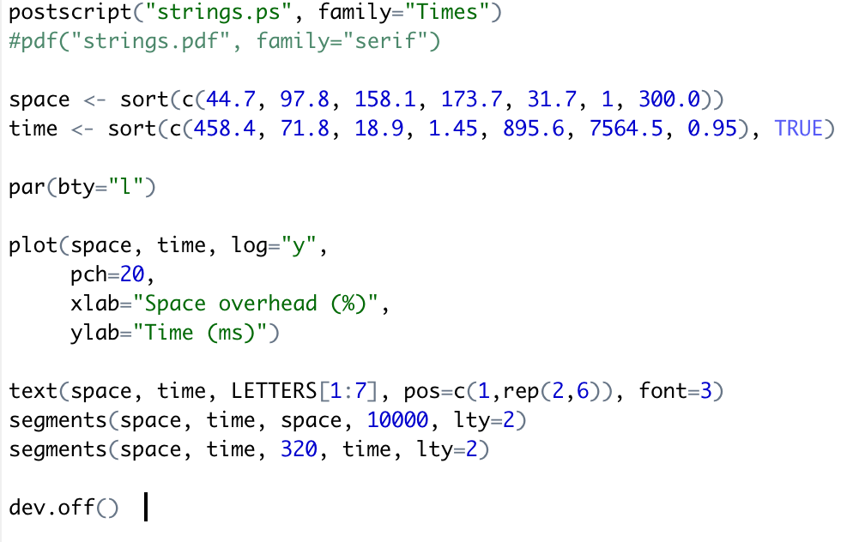
Code Break: Functions 1 (Pre-defined)
Every function in this example is a predefined function in R.
You should be able to find documentation that describes each of these.
①
②
③
④
⑤
Notes:
Identify the input(s), output(s) for each of these functions. Guess what this function might do. What do you do if you don’t know what it does? Look it up in the documentation!
inputs: ”strings.ps” and “family”, no outputs, generates a postscript file. Without context, I might wonder what it makes a postscript file of.
Input, a list of values, outputs: one is “space” the other “time”. Function probably sorts those lists. I would look up the sort function to find out what the TRUE is doing in the sort call used to for “time”
Input is “bty”, but would need to look up function to identify what it is doing.
Many inputs, two lists defined earlier, space and time, log= parameter, pch, xlab, ylab. The function probably plots space and time, xlab and ylab provide axis labels, but I would need to look up log= and pch=
This function is interesting because it has neither inputs nor outputs. I would need to look up what this does.

Slide 17
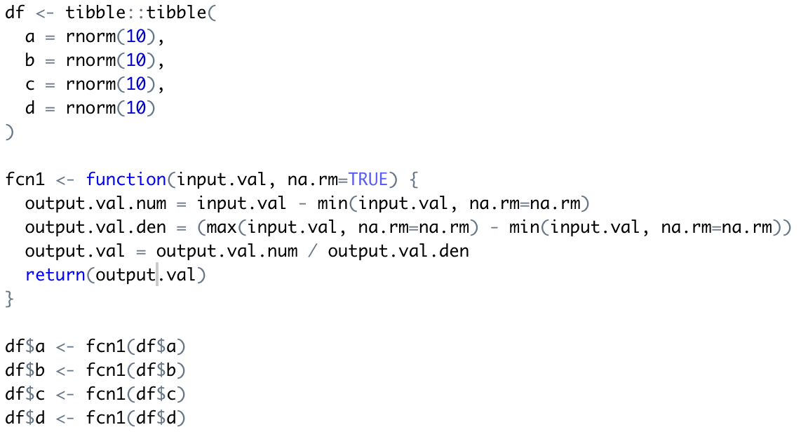
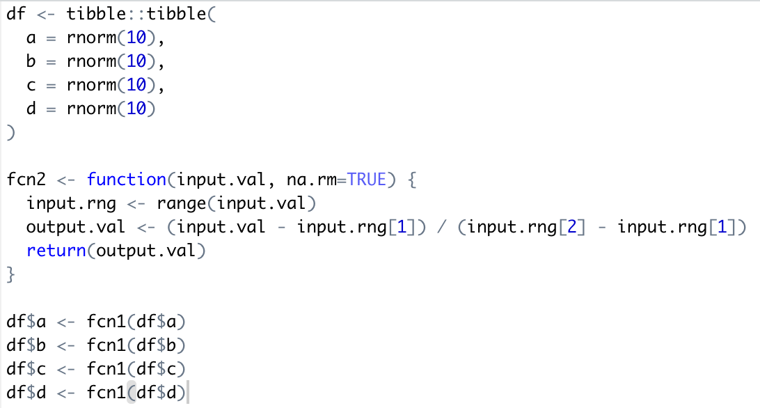
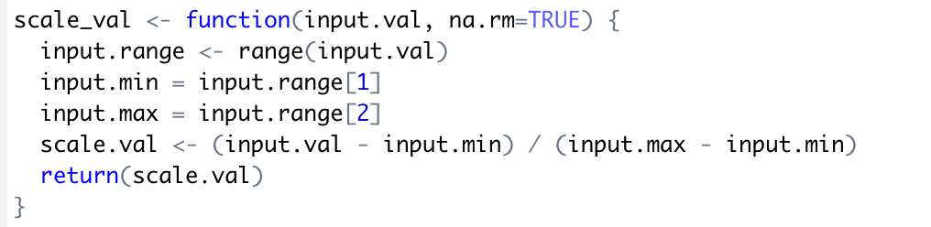
Code Break: Functions 2 (User-defined)
❶
❷
❸
Notes:
Look at these 3 user-defined functions. All 3 of them do the same thing.
Say you were told you had to choose one of these functions and report what the function did. Which would you choose? 1, 2 or 3. Intuitively which one feels the most readable?
What makes it readable?
Most people choose 3, but maybe you didn’t. However, this does highlight that sometimes what is easy to write is not easy to read and vice versa. This is why reading other people’s code is hard. There are a lot of different ways to write the same code.

Slide 18
Object-Oriented Code
term | description
class | Structure that encapsulates a discrete concept
properties | Variables associated with an object
methods | Operations and manipulations, i.e. functions
object | Specific instance of a class
Encapsulates data and code
Abstraction
Controls user interaction with and access to a class
Notes:
That last thing I want to cover is Object-oriented code. Object-oriented programming (OOP) is a popular style of programming which can make development for certain tasks much simpler. Before I describe it in more detail here’s some lingo…
At the center of OOP is the class, which is an encapsulation of properties (data or variables) and methods (functions) that are associated with the class. OOP promotes abstraction. That sounds fancy, what does that mean? Saturday mornings are Smoothie Time in our house. We have a Blendtech blender into which we throw our smoothie ingredients of choice and some ice and hit the smoothie button. The blender has some internal mechanisms and logic for running in “smoothie mode”. I don’t have to understand anything about it beyond hitting the little button with the picture of a smoothie on it. That is abstraction in a nutshell. OOP allows abstraction through code. It is a way to control what the user needs to understand in order to use the code.
Another key value of OOP is that it allows inheritance. This means you can define a base class (e.g. vehicle) which has basic properties and methods. These properties and methods can then be inherited by advanced classes (e.g. truck inherits from vehicle). You might encounter class files, but you will definitely encounter code that instantiates a class (i.e., creates an object), sets properties and calls methods.
Let’s look at an example of a class definition (which you may or may not ever have to deal with) and the use of the class in some code.

Slide 19
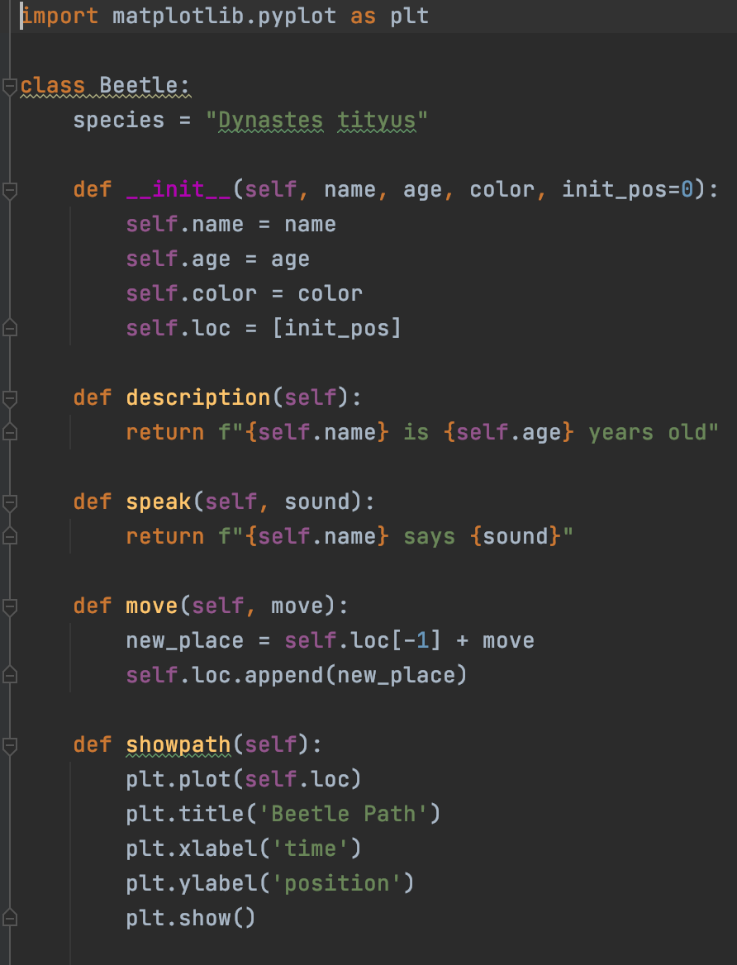
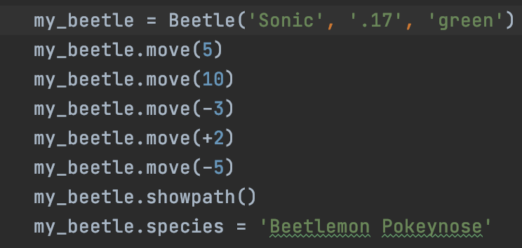
Code Break: OOP
Can you tell which lines have properties and which have methods
Properties are like nouns
Methods are like verbs
Notes:
The left side shows the class definition of the beetle object.
Our class is called “Beetle”
We set species in the class.
We have an initialization function (all classes have this). This is any code that should be run wen we instantiate (create) an instance of the class (create an object). We initialize 4 additional properties of the beetle: name, age, color and loc (location).
Then we have 4 methods: description which returns a description of the beetle, speak which makes our beetle “speak”, move which changes the location of our beetle and showpath which will visualize all the places our little beetle has traveled (when we have used the loc method).
The code on the right shows how to:
initialize an instance of the object
call the move method
Call the showpath method – what is a small difference between move() and showpath()?
Change the species associated with my_beetle

Slide 20
Conclusions
This has been a lot: you’ve earned some chocolate!!
Hopefully, this workshop has given you a vocabulary and high-level understanding of what you need to figure out when you are reading someone else’s code.
Important things to remember:
Don’t underestimate your ability to figure out what’s going on
Don’t be afraid to find a friendly neighborhood computer geek to be your buddy. We love to talk shop.

Slide 21
Thank You!
https://xkcd.com/1695/
Remember: Everyone struggles with reading someone else’s code!!!
NEED HELP? Try
Data Visualization Services @ NC State Libraries
Chat, Email and Zoom Consultations available.
Shout out to the Peer Scholars’ program for providing me with this opportunity!
Notes:
Thank you for attending this Workshop!
Also, thanks to the NCSU Library’s Peer Scholars’ program for providing me with an opportunity to give it.
And…

Slide 22
Resources
Google Doc-Links to Resources
Focus on sites that have fairly basic, comprehensive information.
Notes:
We’ll put a link to this document below the video.

